Slide 1
Cyber Readiness:
Preparing for
Cyber Operations
13 January 2016
Roy E Horton III
Portfolio Manager – Air Force Cyber
National Security Sector
15-Leidos-0630-1397

Slide 2
Agenda
Leidos / Cyber Statistics
Key Technical Topics and Future Opportunities
Solutions and Ideas
Acquisition Topics
Open Discussion

Slide 3
Leidos Corporation
NATIONAL SECURITY SECTOR
~$3.6B revenue | Critical mission support for intelligence community
~13,500 employees with >10,500 possessing security clearances | Security clearances include DoD, TS/SCI, SAP/SAR, and DoE
99% government <1% commercial | Industry-leading cyber solutions and capabilities for DoD, IC, and Federal Customers
FY2014 REVENUES
~$5B
HEALTH and ENGINEERING SECTOR
~$1.4B revenue | Healthcare information technology, electronic health records, and advanced data analytics
~9,500 employees | Health and life science/ clinical research
~63% government ~37% commercial | Energy grid and critical infrastructure design and integration
Notes:
At almost $6B ($5.9B) in size, we are an established player in all our markets.
• Leidos is structured into two operating Sectors.
• National Security is our largest Sector, and comprises roughly two-thirds (68%) of the company’s revenue.
• We are a leading provider of critical mission support for the US Intelligence Community, and have a long history of delivering superior scientific R&D, engineering, data analytics, and systems integration solutions to the U.S. military, agencies of the DoD, and the DHS.
• A significant portion of our national security business is Cybersecurity; and these credentials are truly industry-leading. While others merely redefine IT and label it as cybersecurity, our Cybersecurity is more sophisticated and of greater scale than our competitors. We execute $700M of high-end cyber business annually. And have a full range of solutions to anticipate & protect, detect & defend, or respond & recover to the major, complex cyber-attacks our nation endures. As the largest provider of cyber analysts to the National Security Agency and other Intel agencies, we are at the forefront of cyber protection.
• Finally, most of our National Security employees have the highest-level security clearances, entrusted only to those who carry the full responsibility for our nation’s security.
• Our Health and Engineering Sector is the remaining one-third (32%) of Leidos and has some exciting growth areas. Here, we serve both government and commercial customers across a wide variety of markets, but our strong positioning in commercial business provides an important offset to being pure-play defense contractor.
• And we are not a new entrant to these businesses—in both the Health and Engineering markets, we’ve had over 20 years of successes.
• We solve hard problems and deliver sustainable solutions that can support a better quality of life for generations to come.
• Today, with almost $800M (14%) annually in our Health business, of which about $450M is commercial, we are now a leading provider of electronic health records optimization and implementation in the US.
• Moving to our Leidos Engineering business, what if you could better solve todays’ energy, environmental, and infrastructure challenges while preparing an organization for success in the future? With $1.1B (18%) annually in our Engineering business, we make “what if” possible.
• We have more than 5,000 professionals dedicated to engineering solutions to improve our client’s performance in:
• energy generation, efficiency and management (for example in SmartGrid)
• environmental services (such as remediation, well monitoring, etc.)
• and critical infrastructure design & build projects (such as the Plainfield & US Geothermal power plants).

Slide 4
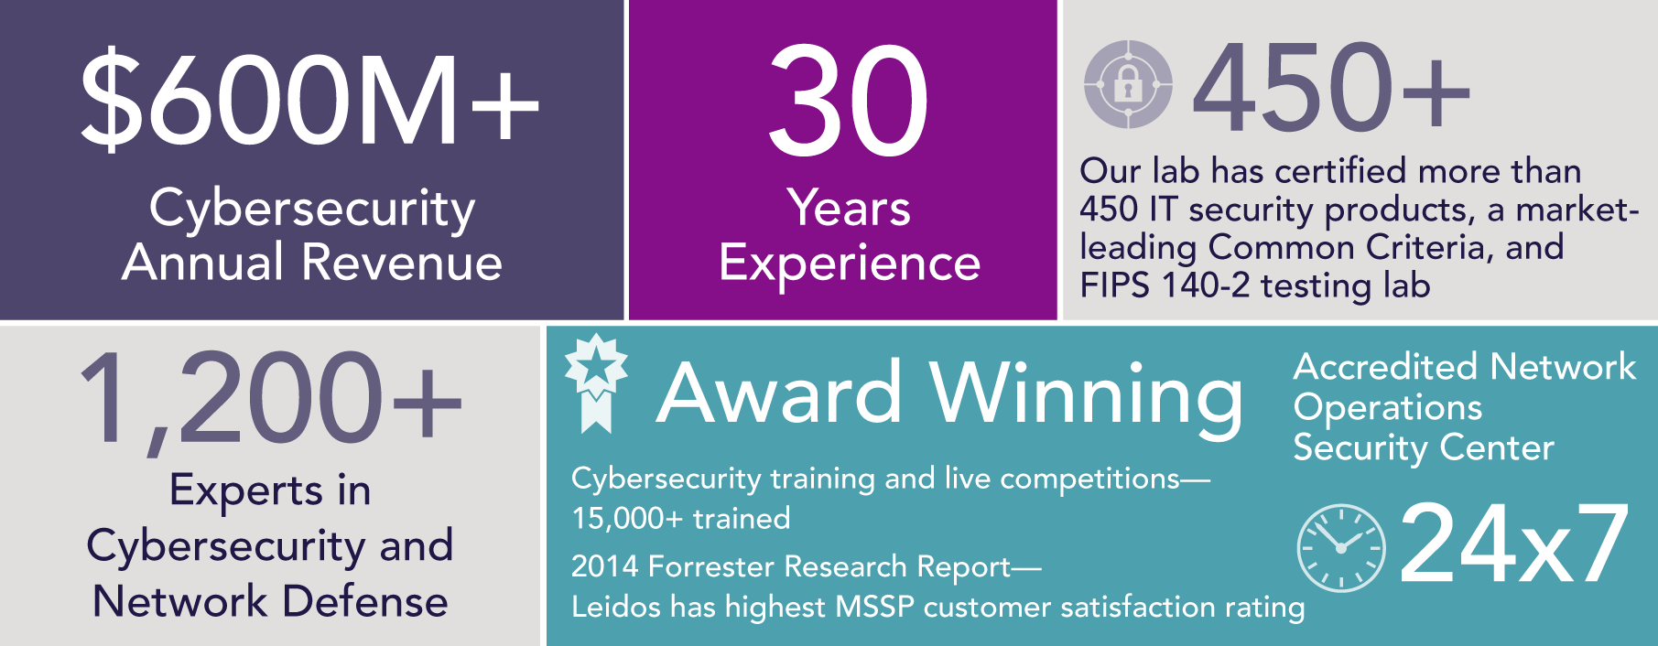
Proven Cyber Performance
With decades of experience managing cyber risks and threats, we offer trusted insights and solutions in cybersecurity
Leidos cybersecurity offerings deliver smart, cost-effective solutions tailored to customer needs and threat profile. We protect the nation’s critical systems from cyber attacks with proven solutions in real time, including DoD, IC, Fed/Civ, and commercial

Slide 5
Cybersecurity Outlook
Threat Drivers
Rapid rise in complex, diverse, persistent and morphing threats to networks, devices, data and other infrastructure
Policy Drivers
Executive branch vs legislation that reflects diversity of opinion. Compliance policy bolsters spending on existing frameworks. RFP language both driving and requiring security
People Drivers
Challenge: find enough qualified cybersecurity professionals; agencies that supplement by contracting will drive spending
Technology Drivers
Threats and vulnerabilities drive direct technical remedies while new, disruptive technologies require security for full adoption

Slide 6
Cybersecurity Outlook – Follow the $

Slide 7
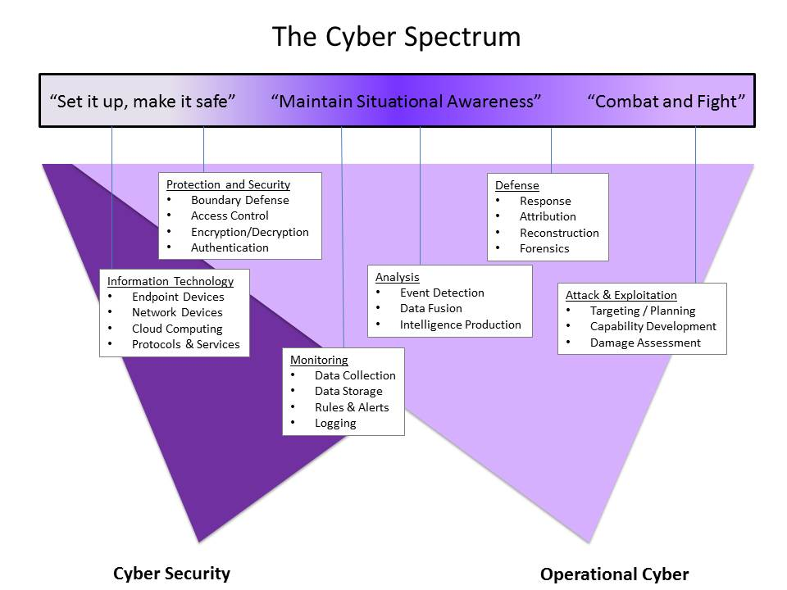
How do you define “Cyber?”

Slide 8
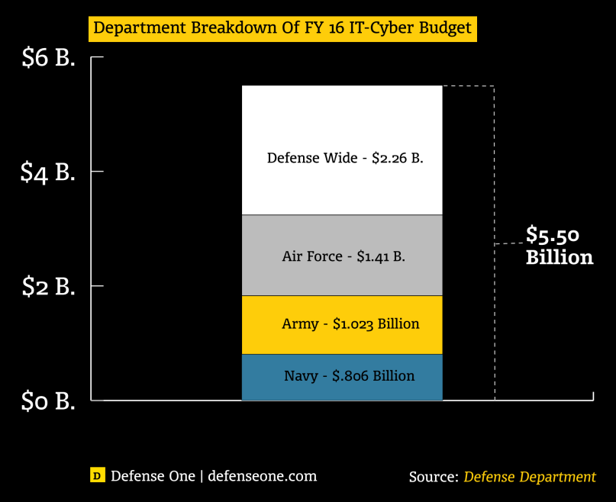
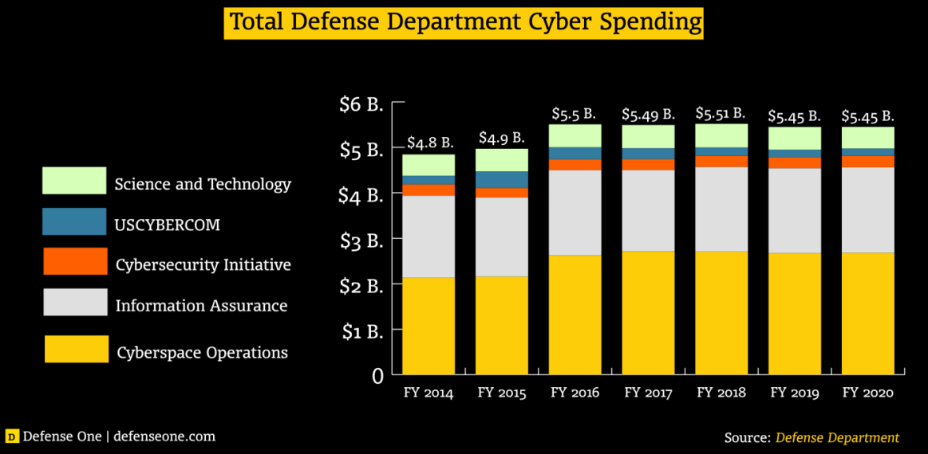
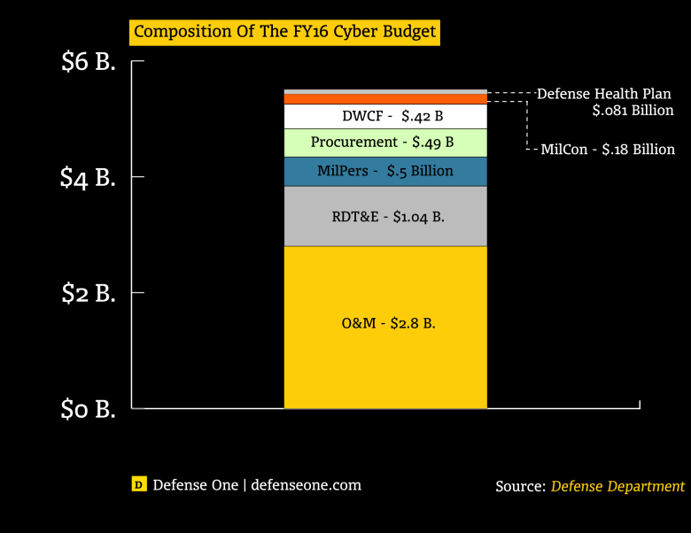
DoD Cyber Budget
Information Assurance and Cyber Operations
Comprise 80% of the Cyber Budget
IT Budget is ~7 times the Cyber budget

Slide 9
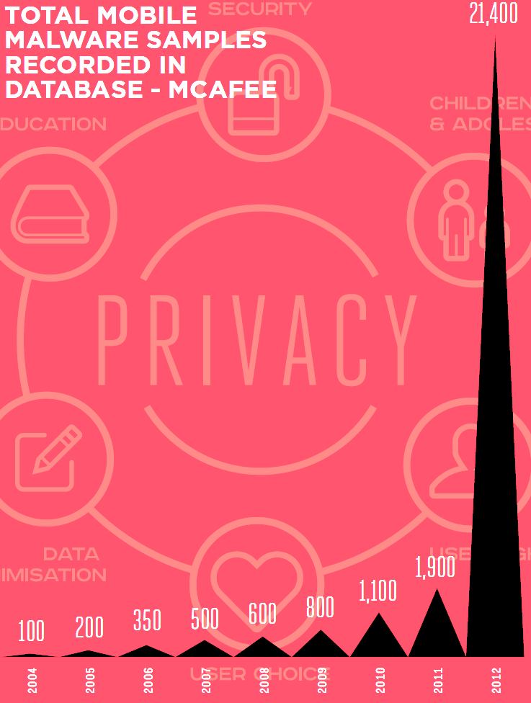
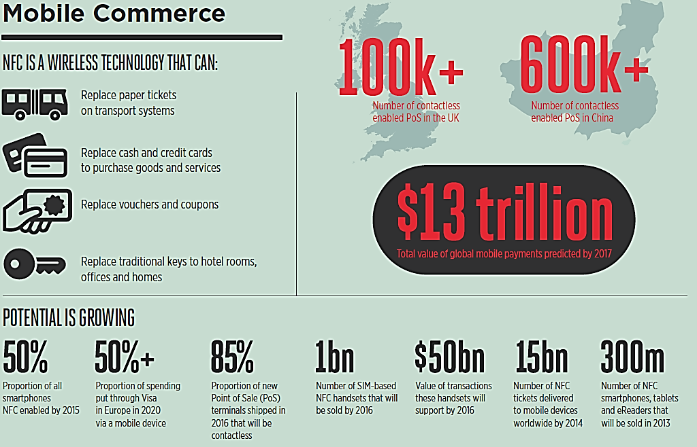
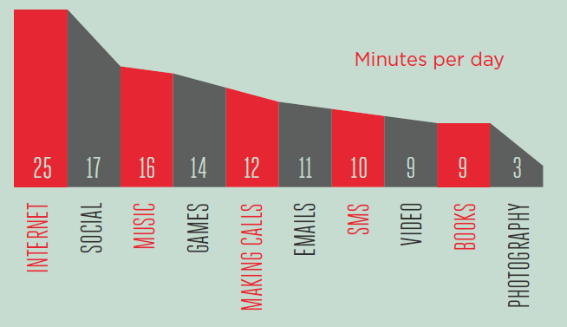
Cyber Trends
In 2017…
Mobile data volume will exceed 11.2 ExaBytes per month
There will be 3.9 Billion mobile subscribers (growing 4x faster than the global population)
The predominant mobile market continues to be the Asia Pacific, with over 50% of global connections
And technology continues to evolve (rapidly)
Source: GSMA Intelligence, CISCO 2013 Mobile VNI Study, Machina Research, A.T. Kearny Analysis

Slide 10
Cybersecurity Outlook – Key Trends
Cyber-threats challenge agency progess in cybersecurity hardening
Breadth/depth of threats vs complexity of agency IT environments
Agencies will continue to look to industry for help.
IT spending relatively flat but growth opportunities remain
Cloud, big data, mobility, and infrastructure will support growth
Agency maturity in security strategies and processes will drive demand for services and products
Strategy and cyber-ops services show sustained demand
Top needs: improved monitoring, effectiveness, and automation
Skilled personnel needs will sustain demand for contracted services
Cybersecurity will be embedded into Fed IT acquisitions and mgmt
Security widely impacting acquisition policy, contract types, and RFPs

Slide 11
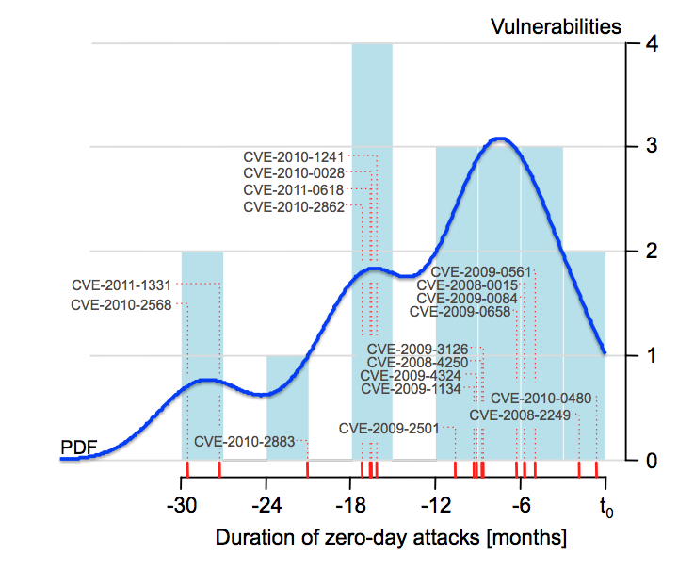
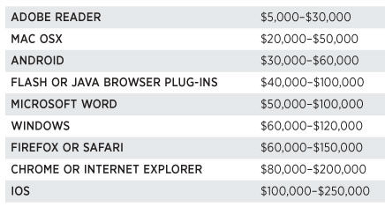
Zero Days
Symantec reported that zero-days survive an average of 312 days before being patched
According to Forbes, zero-days routinely sell for 6 figures (based on target software and complexity of the vulnerability):
http://www.forbes.com/sites/andygreenberg/2012/10/16/hackers-exploit-software-bugs-for-10-months-on-average-before-theyre-fixed/
http://www.forbes.com/sites/andygreenberg/2012/03/23/shopping-for-zero-days-an-price-list-for-hackers-secret-software-exploits/

Slide 12
Full Spectrum Cyber Operations
Key Technical Topics and Future Opportunities

Slide 13
Cyber Lines of Operation
Operate the Network
(DGO)
Defend The Network
(DCO)
Engage the Adversary
(OCO)
Technology
Tactics / Techniques / Procedures
People / Skills
By 2018, there will be 133 teams consisting of almost 6,200 military and civilian personnel who have been trained and equipped with the tools and infrastructure to defend US cyber space

Slide 14
DoD GIG Operations (DGO)
Key Technology Areas
Cloud Computing
IaaS, PaaS, SaaS
Moore’s Law
Automation/Prediction
Future Opportunities
Cost Efficiencies
Virtualized infrastructure
Security as a Service
Exponential increases in Storage/Bandwidth/Processing
Help Desk Support
Real-time problem resolution
Fewer tickets due to predictive failures
Notes:
IaaS – Infrastructure as a Service (Amazon Web Services (AWS), Microsoft Azure, Google Compute Engine (GCE), Joyent)
PaaS – Platform as a Service
SaaS – Software as a Service (Google Apps, Salesforce, Workday, Concur, Citrix GoToMeeting, Cisco WebEx)

Slide 15
Defensive Cyber Operations (DCO)
Key Technology Areas
Information Sharing
Visualization / Situational Awareness
Increasing attacks
Quantity
Sophistication
Future Opportunities
Threat Intelligence
Big Data Systems
Automated Analysis
Data Science & Human Factors Engineering
Technology & Skills
SDN, DPI, Threat Intelligence
Training and Maintenance

Slide 16
Offensive Cyber Operations (OCO)
Key Technology Areas
Vulnerability Research & Exploitation
Deterrence Strategies
Delivery Platforms
Future Opportunities
Automated techniques
Fuzzing
Automated Static Analysis
Weapons “stockpiling”
0-days, n-days
Non-Internet-based
SDRs
Internet Of Things (IOT)

Slide 17
Solutions and Ideas
Industry/Government Collaboration

Slide 18
Training the People
How we do it today:
Commercial Products (e.g., CyberNEXS)
Commercial Training
SANS, INFOSEC Institute, etc.
DoDI 8570 and certifications
Security+, GSEC, CEH, CISSP, etc.
Mission-Focused Training
JCAC, NETA, etc
How we can do it better:
Incorporate “DoD-like” cyber proponency in formal education curriculum
High School & College
ROTC / JROTC
Better engagement through STEM outreach
Notes:
SANS
INFOSEC Institute
Security+
GSEC
CEH
CISSP
JCAC
NETA

Slide 19
Equipping with Resources
How we do it today:
Periodic “refresh” of IT equipment (Network Infrastructure, Computer Systems and Devices)
Cyber Tool Development and Testing
Operations Centers
How we can make it better
Use of Big Data to enable prediction and trend analyses
“Weather modeling”: Advanced simulation of cyber effects
Better Situational Awareness tools and capabilities (through Big Data, data science and advanced user interfaces)

Slide 20
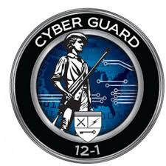
Maintaining Readiness
How we do it today:
Exercises (Cyber Knight, Cyber Guard, Cyber Flag, CDX, etc.)
Advanced training & mentoring
How we can make it better
Proficiency development and maintenance
Cross training of related skills into OCO/DCO/DGO
Cyber “shooting ranges”

Slide 21
Acquisition Topics

Slide 22
Cyber Contracts: Myths and Reality
Myth: A shorter PoP is better due to the pace of evolution and innovation in the cyber domain.
Reality: Longer PoPs grow mission “partnerships” with industry. Selecting a contractor with strong leadership in cyber technology and services will bring faster innovation that will meet mission requirements
Myth: Firm Fixed Price contracts lower risk for the Government, and ensures the contractor delivers a usable solution.
Reality: Contractors price risk into Fixed Price proposals, effectively increasing cost to the Government. Additionally, Fixed Price bids define rigid scope, and any work outside scope will result in ECPs.

Slide 23
Cyber Contracts: Myths and Reality
Myth: Low Price Technically Acceptable is a preferred evaluation mechanism for cyber contracts, due to the ease of evaluation.
Reality: Because cyber technology, TTPs, and skills are so diversified and constantly evolving, best value would allow the Government to better understand pros and cons to different approaches.

Slide 24
Leidos Contact Info
Ron Fodor
ronald.j.fodor@leidos.com
Roy E Horton III
roy.e.horton.iii@leidos.com

